Slide 1
Community Management System
Nov 5, 2022

Slide 2
Problem
小区的新房住户经常向小区物业抱怨各种问题，诸如房屋出现问题需要小修小补，寄来的包裹丢失，公共娱乐室预订时间冲撞，小区管理费滞纳，物业信息沟通不畅等。小区有雇佣专业的管理公司负责小区管理，但是人工效率低下，问题依旧频出且业务手段非常守旧。针对该问题，小区希望开发一个管理系统为小区物业、第三方管理公司和小区居民提供一个三方协作沟通平台，帮助提高小区管理效率，解决物业问题。

Slide 3
Solution
Service Request
房屋出现问题需要小修小补
Tenant can check, cancel and send their request
Service provider can check and accept the request
Booking Room
公共娱乐室预订时间冲撞
Tenant can book and cancel a room
Tenant can check the availability of each room
Payment
小区管理费滞纳
Tenant can check each payment details and pay
Manager can check each payment and bill late fee invoice to the late payment
Message Forum
物业信息沟通不畅
Tenant can post and delete their message
Manager can post announcement to all tenants

Slide 4
User
Tenant
Manager
Service Provider
register, login
Pay rent
Request service of maintenance -> track the status of that maintenance
Reserve common rooms
Post thread in marketplace forum
register, login
Make announcement on news board
Reserve common rooms
Request customized late fee for late payment
Can also using Message Forum as Tenant
register, login
change vendor of service request -> change the status of service request to resolved upon completed

Slide 5
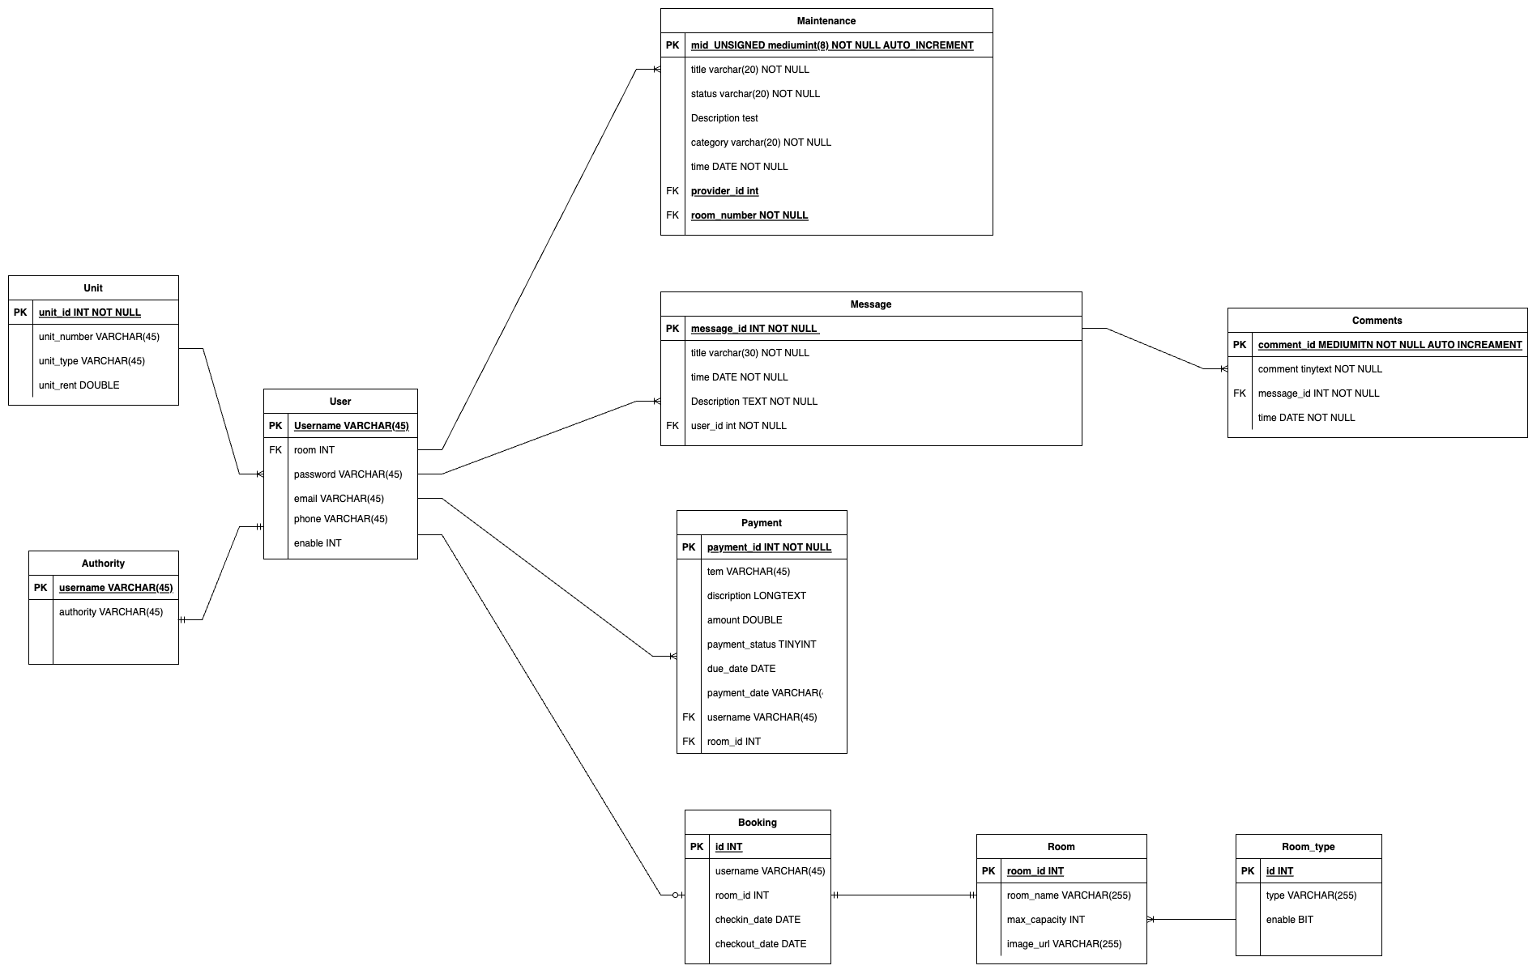

Slide 6
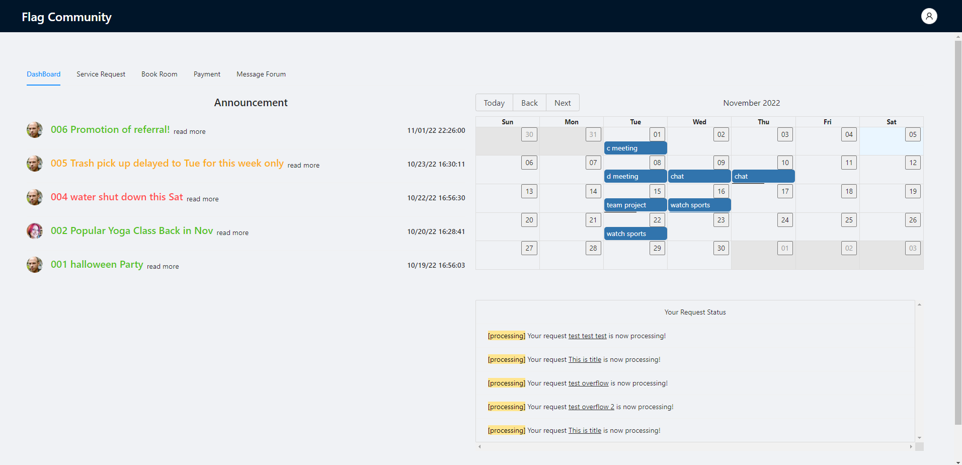
DashBoard
getAllAnoucement
getMyRoomReservatio
getMyProcessingService

Slide 7
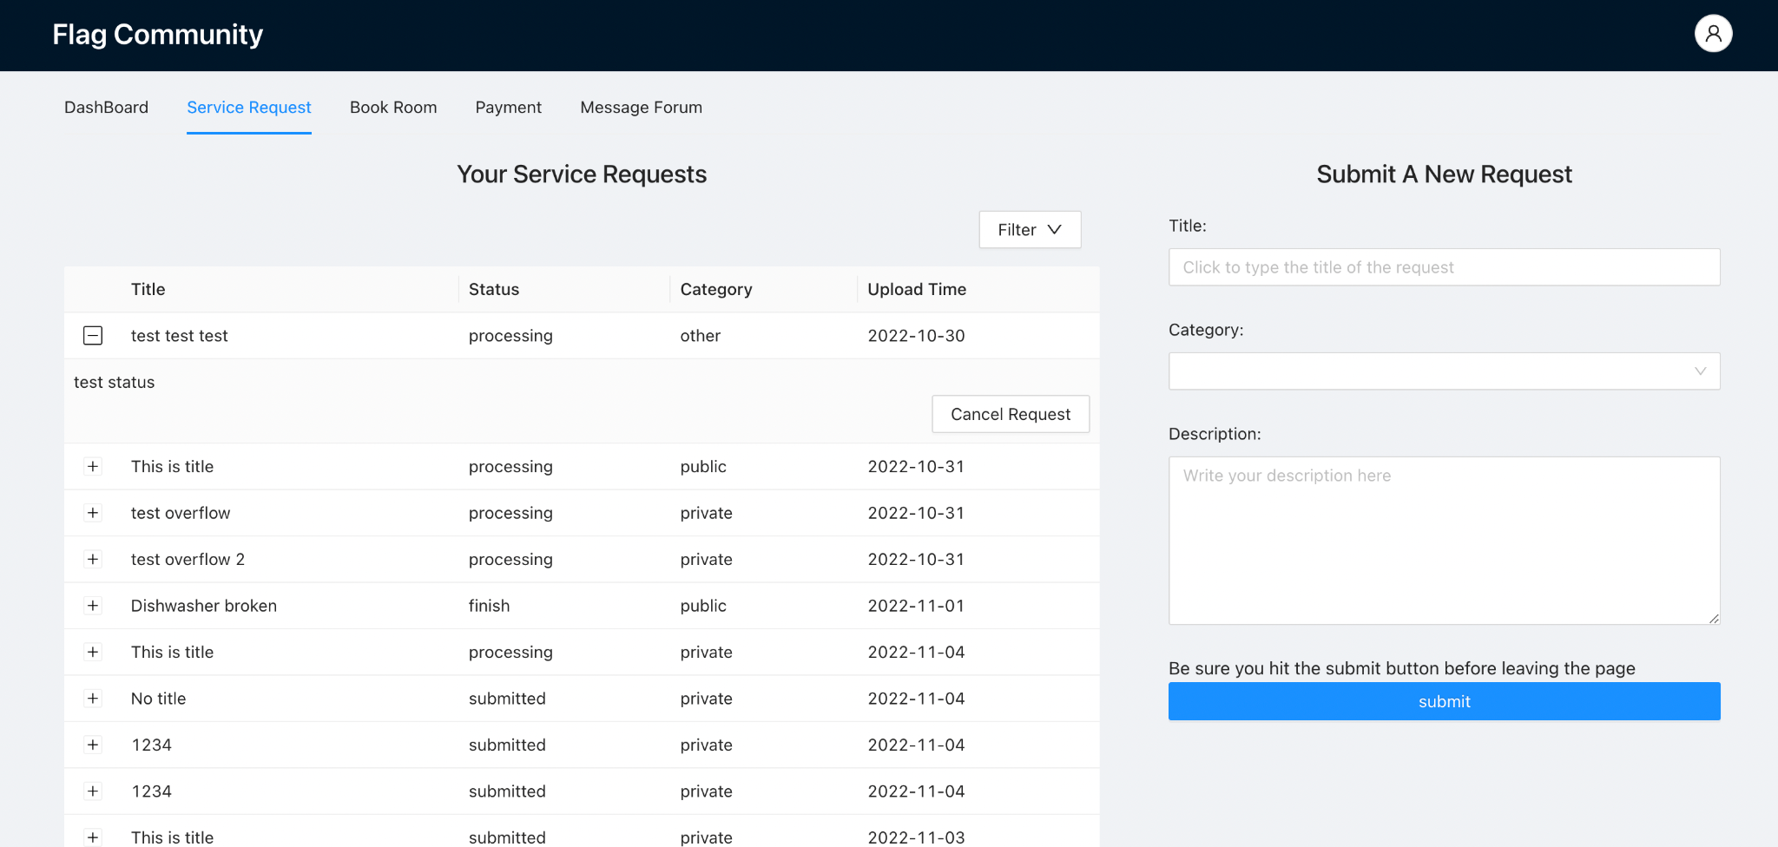
Service Request
Tenant
sendRequest
cancelRequest
getTenantRequest
Provider
getAllRequest
assignRequest
finishRequest
getRequestByTenant
getRequestByStatus

Slide 8
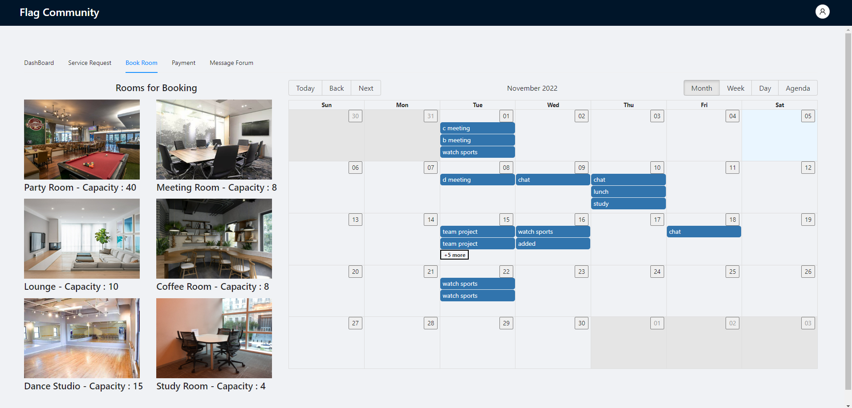
Booking
getReservations
bookReservation
cancelReservation

Slide 9
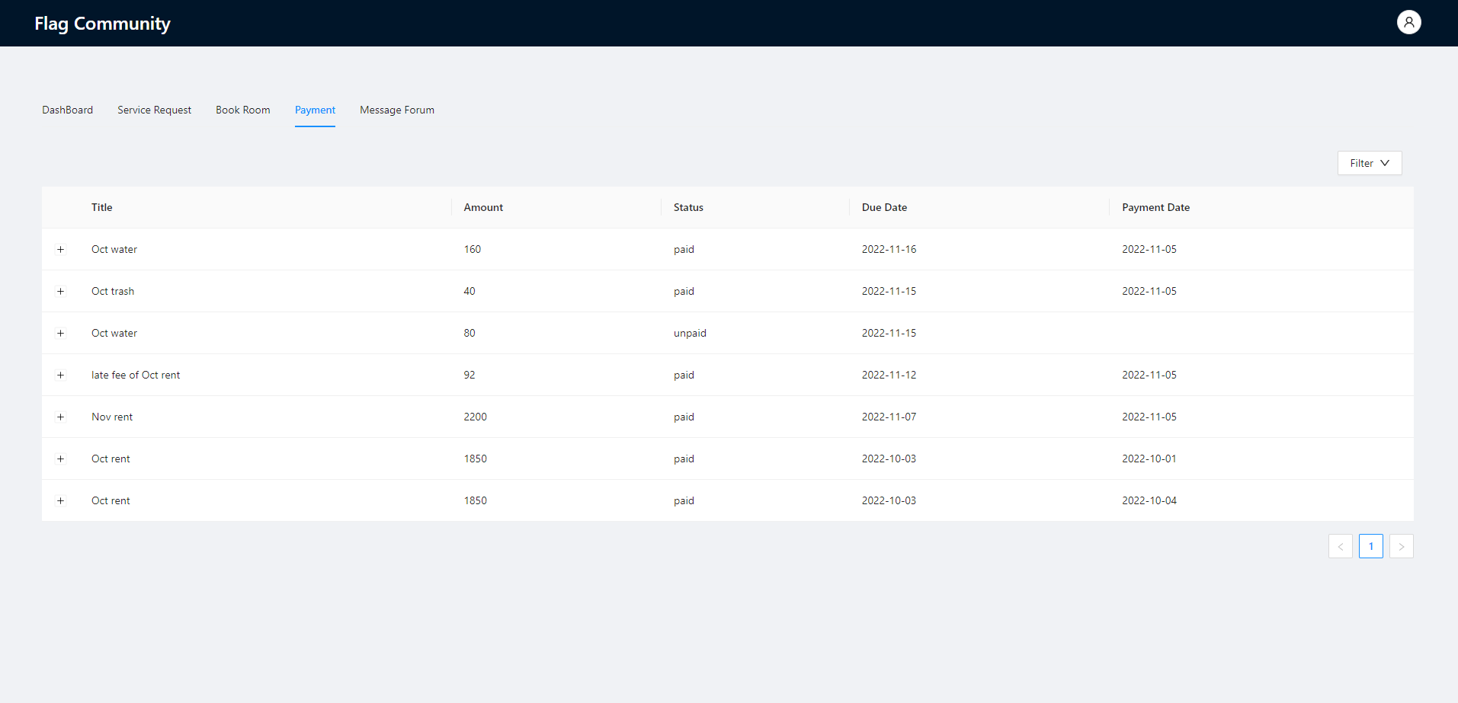
Payment
Tenant API:
getMyInvoice
getMyInvoiceByStatus
payMyInvoice
Manager API:
getAllInvoice
getAllInvoiceByStatus
getOverdueInvoices
getLatePaidInvoices
createBillByLateDates

Slide 10
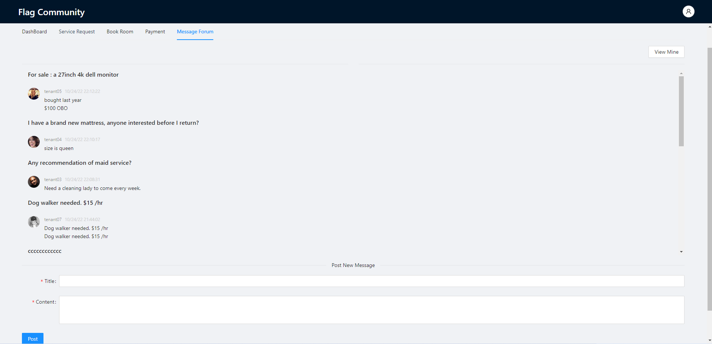
Message
getTop10Messages
getMyMessages
postNewMessage
deleteMessage

Slide 11
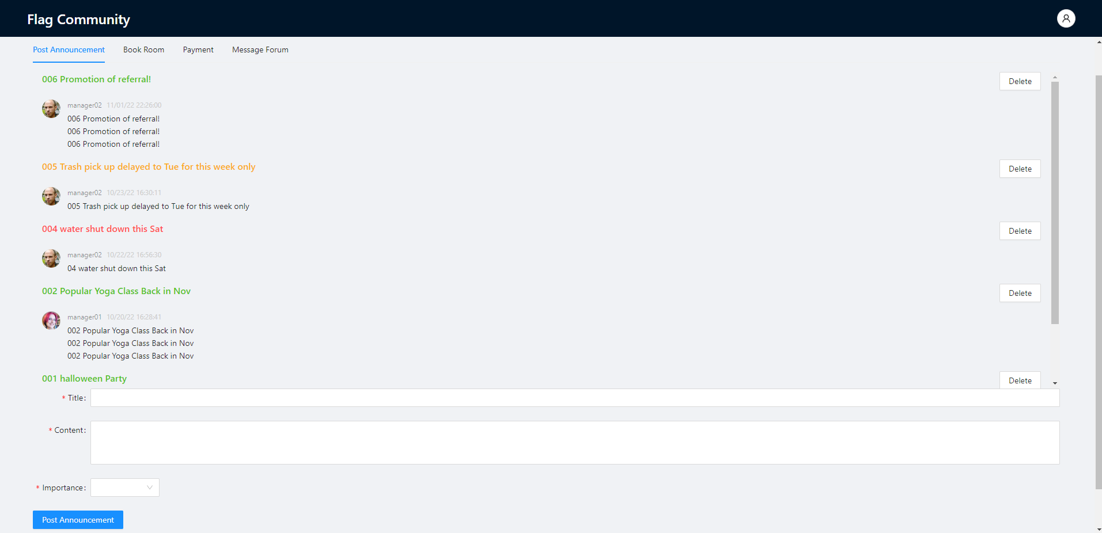
Manager - Announcement
getAllAnouncement
postNewAnouncment
deleteAnouncement

Slide 12
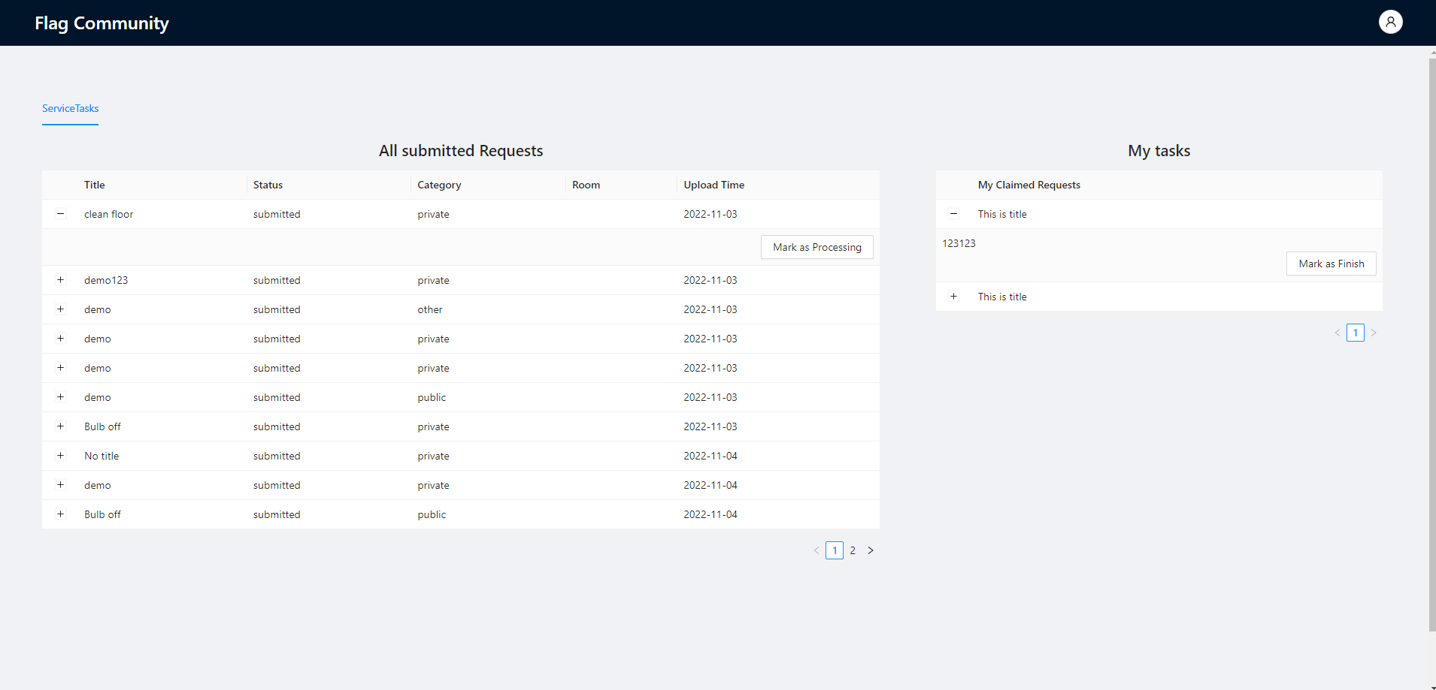
Provider
getAllRequestByStatus
markRequest

Slide 13
分工，项目管理
按照功能分成四个组
Service Request: Chen(BE), Haolin(FE/BE), Zhiqi Bei(FE/BE), Boyan Tian(FE/BE)
Book Room: Daiming(FE), Zihan(FE/BE), Liang(BE) jiamin Wang
Rent Payment: Ziyue Wang(BE/FE), Yuan Xue(FE/BE), jiamin Wang,
Post Messages: Lisha(BE) /Haojin(BE), Yuhan(FE/BE), Boyan Tian(FE, BE)
每周1-2次meeting，汇报每组进度

Slide 14
Technical Challenges
Instead of selecting time from a drop down menu, drag and select time slots on a calendar is more sophisticated and challenging.
Data race problem due to react's asynchronized useEffect functions.
Auto refresh brother component after one child component is updated.

Slide 15
Improvement Needed
Function of statistic report for manager and provider about service request and payment.
Function of reply messages.
Real payment function.
Screen adaptive display.
Scalability and efficiency.
Expanded table can't automatically collapse after changing filter.
Show room name in the service request list for provide.

Slide 16
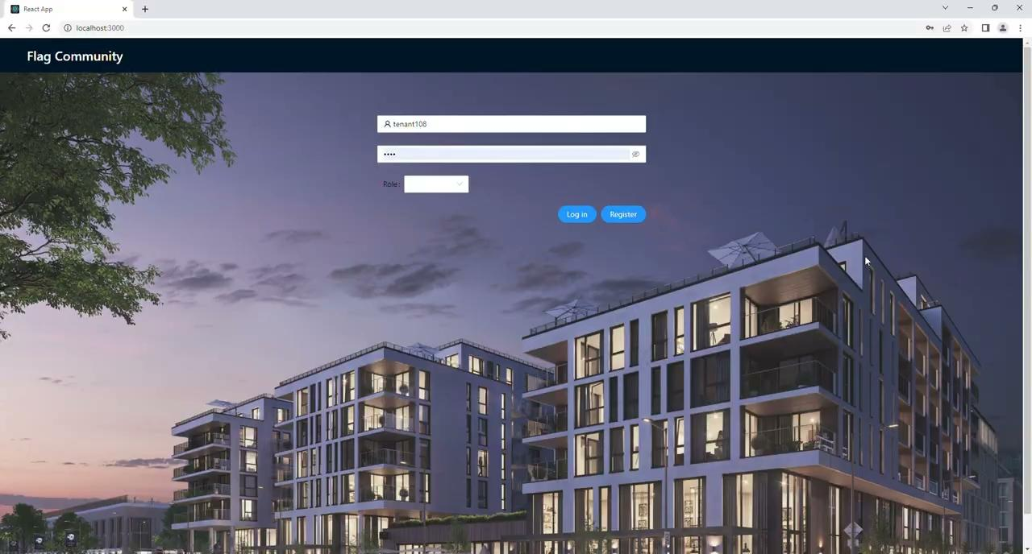
Demo

